Slide 1


TOURISM MANAGEMENT SYSTEM
Naga Jajilli : 201FA07060 Ashish : 201FA07047
Juhi Kumari : 201FA07075

Slide 2

TABLE OF CONTENTS
S.NO | NAME
1. | Abstract
2. | Existing System
3. | Proposed System
4. | Software & Hardware Requirements
5. | Module
6. | Module Description
7. | Data Flow Diagram
8. | Screen Shots
9. | Backend Tables
10. | Result Screen Shots
11. | Conclusion
12. | Future Work

Slide 3
ABSTRACT
Tourism Management System is a complete tourist fully integrated tourism web site. The web site covers all the areas required for an including tourism, This project is developed to manage the tourist in the tourism management web site. The main module in this project are login, tourist management, complaints and reports.

Slide 4

INTRODUCTION
Objective of the project is to develop a system that automates the process of a travel.The Travel and Tourism Management System is a web based application and maintains a centralized repository of all related information.
The objective of this project is to develop a system that automates the processes and activities of a travel agency. In the present system a customer has to approach various agencies to find details of places and to book tickets. This often requires a lot of time and effort. A customer may not get the desired information from these offices and often the customer may be misguided.

Slide 5


Existing System
In the present system a customer has to approach various agencies to find details of places and to book tickets. This often requires a lot of time and effort. A customer may not get the desired information from these offices and often the customer may be misguided. It is tedious for a customer to plan a particular journey and have it executed properly.
Proposed System
The proposed system is a web based application and maintains a centralized repository of all related information. The system allows one to easily access the relevant information and make necessary travel arrangements. Users can decide about places they want to visit and make bookings online for travel and accommodation

Slide 6
SOFTWARE & HARDWARE
Software
Technology : Java and J2ee
Web Technologies : Html, JavaScript, CSS
Web Server : Tomcat5.5
Database : MySql5.0
JDK Version : JDK1.5
Hardware
Hardware : Pentium
RAM : 1GB

Slide 7

MODULES
Administrator Module
This module provides administrator related functionality. Administrator manages all information and has access rights to add, delete, edit and view the data related to places, travels, routes, bookings, etc.
Travels Modules
This module provides the details of various travel agencies. A user can select the appropriate agency depending on convenience and accessibility.

Slide 8
Routes Module
This module proves information related to various routes connecting sources and destinations. For each route, information such as source, destination, fare, reservation details, pick up points etc are provides. Only administrator can add, delete, edit and manage the data. Users can only view the information
Reservation Module
This module provides functionalities that allow a user to book tickets or cancel previously booked tickets. The module maintains the details of all reservations made so far and allows administrator to either confirm or reject the bookings.
Testimonials Module
Users of this application can post their opinions, complaints and suggestions regarding this portal and services to the administrator. Accordingly, the administrator can take various steps to act on the complaints and suggestions

Slide 9
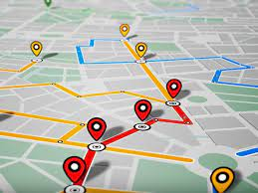
Tracking Module
The Tracking Module will track the customer by dates, hotels, vehicles etc. MIS Reports where generated to keep track of the revenue, agent’s performance, etc., Voucher where generated for the customer for all the accommodation and transport facilities asked by the customer
MODULE DESCRIPTION
The system is proposed to have the following modules:
Administrator module, travels module, routes module, reservations module and Testimonials module

Slide 10
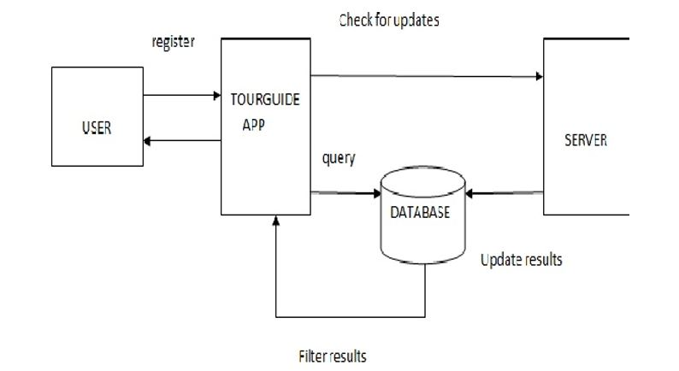
DATA FLOW DIAGRAM

Slide 11
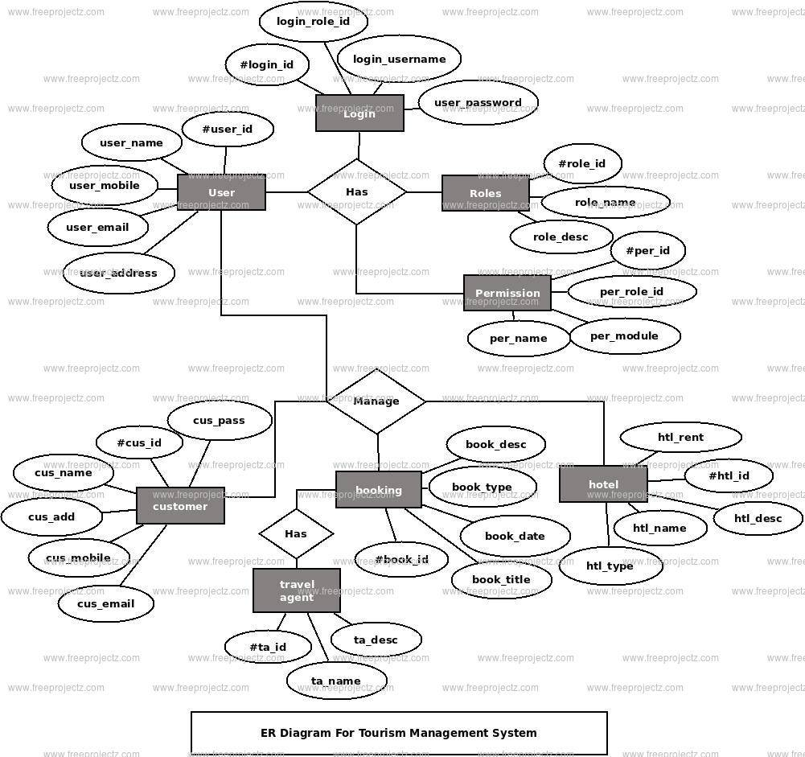
DATA FLOW DIAGRAM

Slide 12
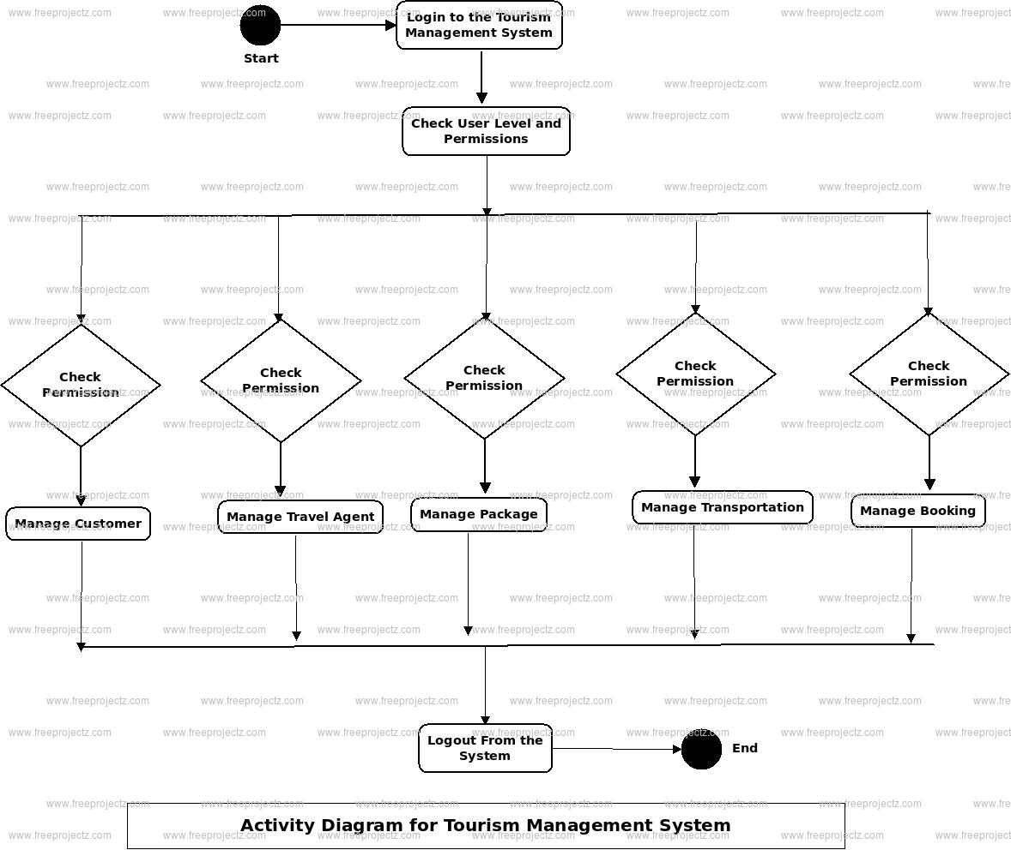
DATA FLOW DIAGRAM

Slide 13
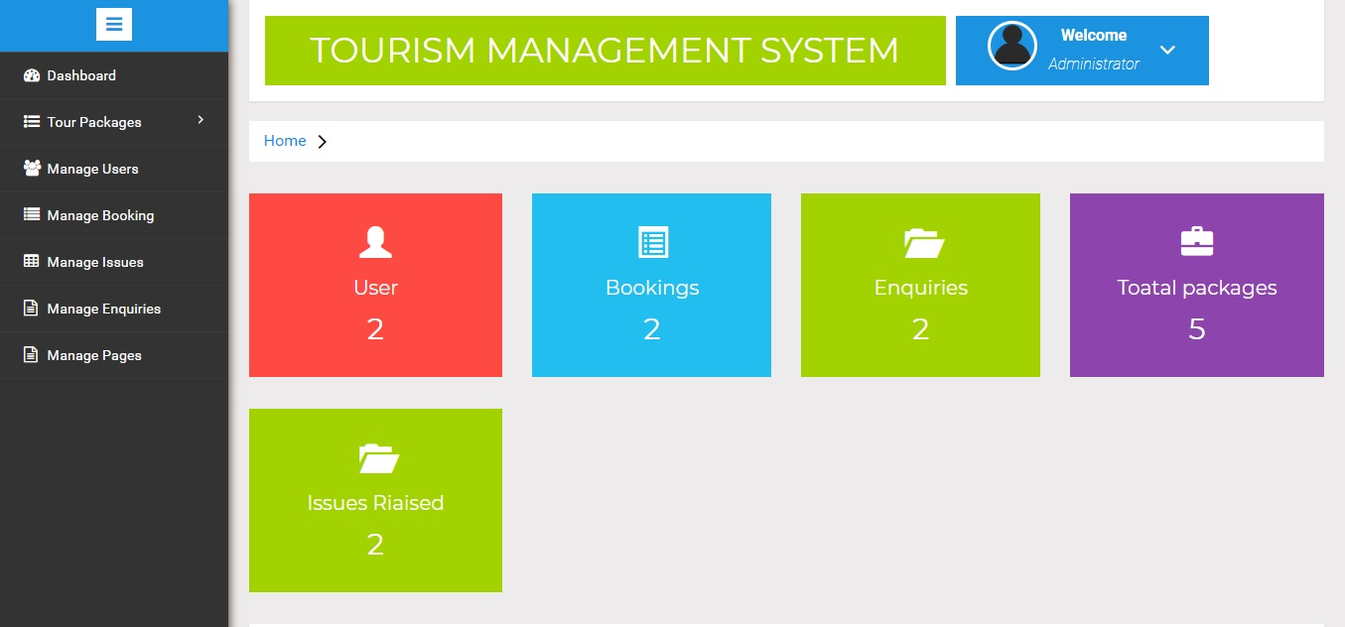
SCREEN SHOTS

Slide 14
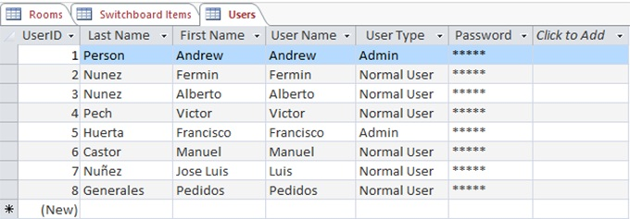
BACKEND TABLES

Slide 15
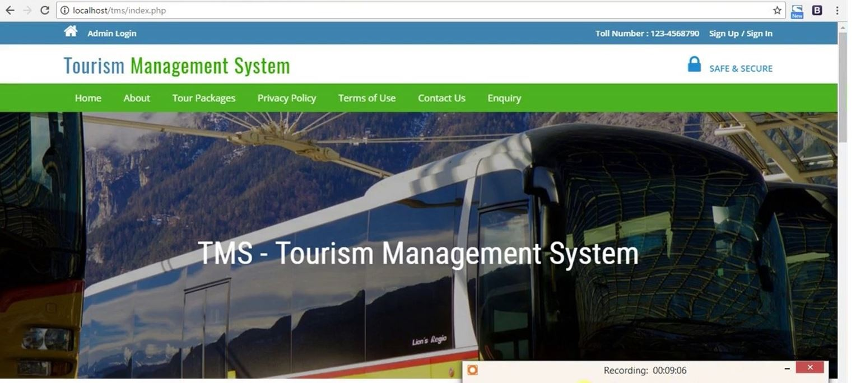
RESULTS SCREEN SHOTS

Slide 16
CONCLUSION
“Travel and Tourism Management System” management process in travelling
Fast processing and immediate results with high security
Minimizing human effort and cost efficient database
Navigation through the site is very easy

Slide 17
FUTURE WORK
According to Ari Steinbuerg, the founder of a travel startup Vamo, the tourists will tend to spend less time planning in advance. Efficient booking services and apps will enable the tourists to create versatile itineraries with reasonable price. Future tourists would not prefer to be confined to packaged tours. With the availability of large number of options, the tourists would prefer to realize every possible wish regarding tourism.
With more flight connectivity, travelling modes and accommodations introducing more comfort, technology helping mankind progressively, the tourism will continue to bring momentum in its sector

Slide 18
THANK YOU

